Slide 1
Project Title: Gentle Reminder App
Team Name: Techno Mind Sparkers
vibeAIthon 2025
“Show. Don’t tell. Bring your idea to life!”

Slide 2
Problem Recap & Objective
Problem Recap:
People with Alzheimer’s or memory difficulties often forget daily tasks, medications, or appointments.
This can lead to missed doses, confusion, and increased stress for both the user and caregivers.
Objective:
To create a mobile app that sends gentle, personalised reminders for medications, appointments, and activities.
The goal is to help users maintain independence and peace of mind while reducing
caregiver stress.

Slide 3
Prototype Overview
The Gentle Reminder App is designed to provide timely alerts with a calm interface.
It enables users or caregivers to set reminders for medications, doctor appointments, and daily tasks.
Technology Stack:
- React Native for cross-platform mobile development
- Firebase for data storage and authentication
- Google Calendar API for scheduling and notifications
Prototype Type: Clickable concept with functional reminder logic and notification simulation.

Slide 4
User Experience & Impact
User Journey:
1. User logs in or signs up.
2. Sets reminders for tasks or medications.
3. Receives calm notifications with voice or vibration alerts.
4. Marks tasks as completed.
Impact:
- Helps Alzheimer’s patients stay organized and independent.
- Reduces caregiver stress by sharing reminder control.
- Encourages routine building with a simple and accessible design.
Next Steps:
• Integrate a voice assistant for accessibility.
• Add AI-based scheduling for adaptive reminders.

Slide 5
Screenshots & Wireframes
Placeholder for app screenshots and wireframes.
Suggested visuals:
- Home screen with reminders list
- Add reminder interface
- Notification pop-up example
- User profile or settings page

Slide 6
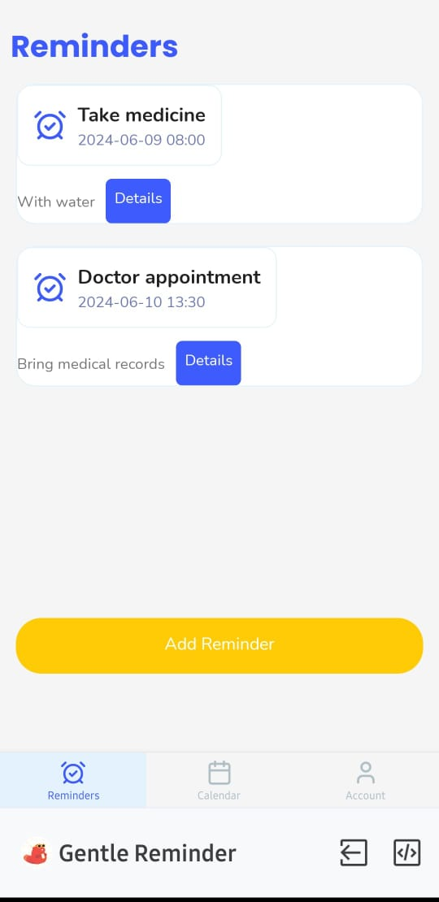

Slide 7
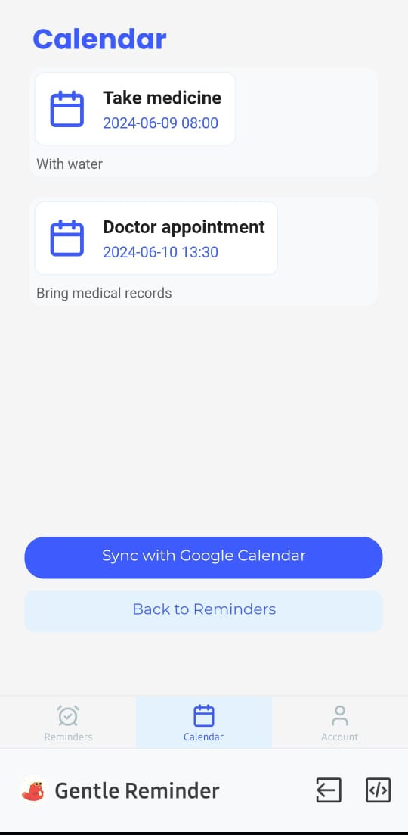

Slide 8
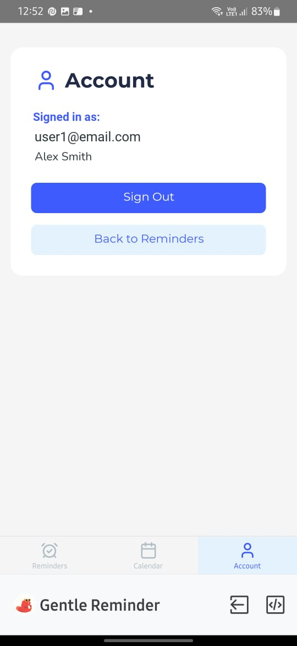

Slide 10
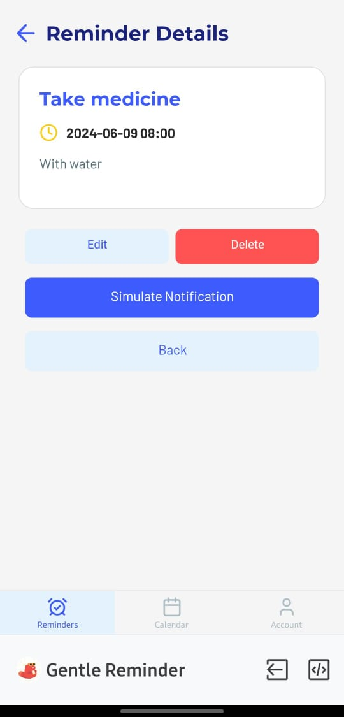

Slide 11
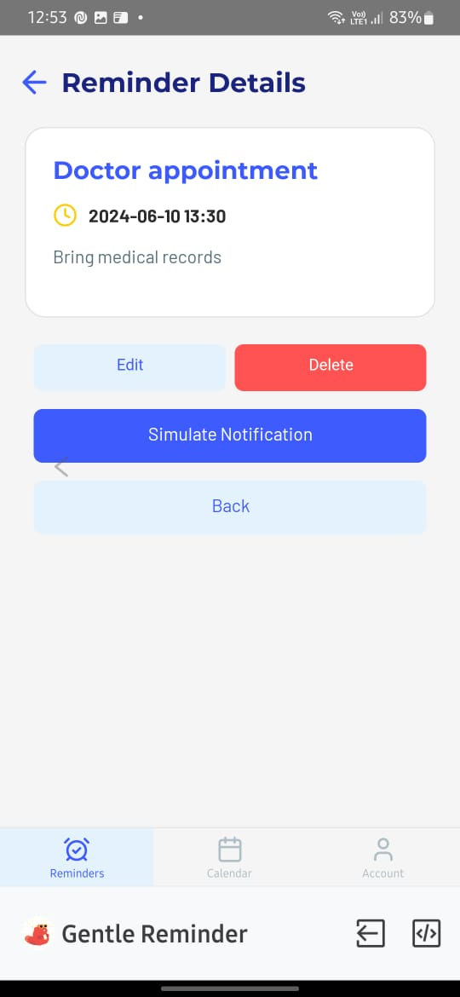

Slide 12
THANK YOU

